Slide 1
EDA Capstone Project
Transport demand prediction
By-Ghanshyam Menariya
Gmail – ghanshyammenariya50@gmail.com
No. - 7689965076
(Cohort Berlin)

Slide 2
Point for Discussion
Data Summary
Problem statement
Variable description
Exploring data analysis
Count the vehicle type
Count the capacity and payment method
count people travel location
Count traveling time
Count number of ticket of each location
Features engineering
implement linier regression
Implement lasso
implement XGBoost
Implement random forest classifier
Conclusion

Slide 3
Problem Statement
This challenge asks you to build a model that predicts the number of seats that Mobiticket (cash or mobile) can expect to sell for each ride, i.e. for a specific route on a specific date and time. There are 14 routes in this dataset. All of the routes end in Nairobi and originate in towns to the North-West of Nairobi towards Lake Victo

Slide 4
Variables description:
ride_id: unique ID of a vehicle on a specific route on a specific day and time.
seat_number: seat assigned to ticket
payment_method: method used by customer to purchase ticket from Mobiticket (cash or Mpesa)
payment_receipt: unique id number for ticket purchased from Mobiticket
travel_date: date of ride departure. (MM/DD/YYYY)
travel_time: scheduled departure time of ride. Rides generally depart on time. (hh:mm)
travel_from: town from which ride originated
travel_to: destination of ride. All rides are to Nairobi.
car_type: vehicle type (shuttle or bus)
max_capacity: number of seats on the vehicle

Slide 5
Exploratory Analysis and Visualization Exploratory data visualizations are the type of visualizations we assemble when we do not have a clue about what information lies within our dataset.

Slide 6
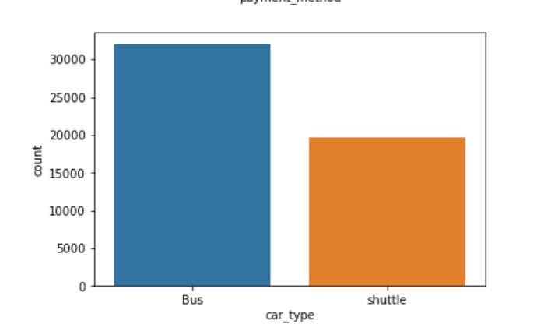
Count the Vehicle type
We can see there are two type of cars available Bus and shuttle and maximum is bus

Slide 7
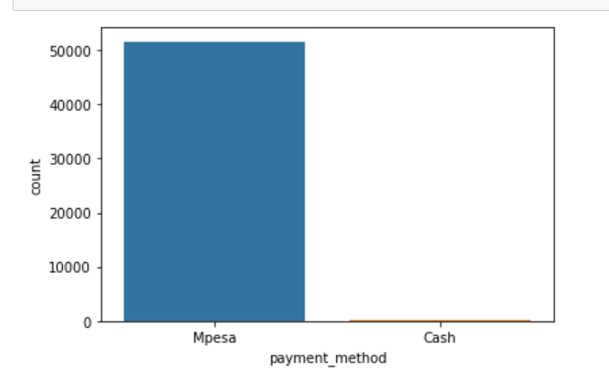
Count the payment method
There are two type of payment methods people have used to buy the tickets.

Slide 8
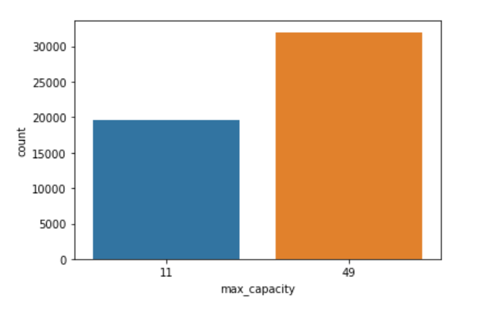
Count the Capacity of Vehicle
We can see maximum capacity of the bus is 49 while shuttle can contain 11 travelers

Slide 9
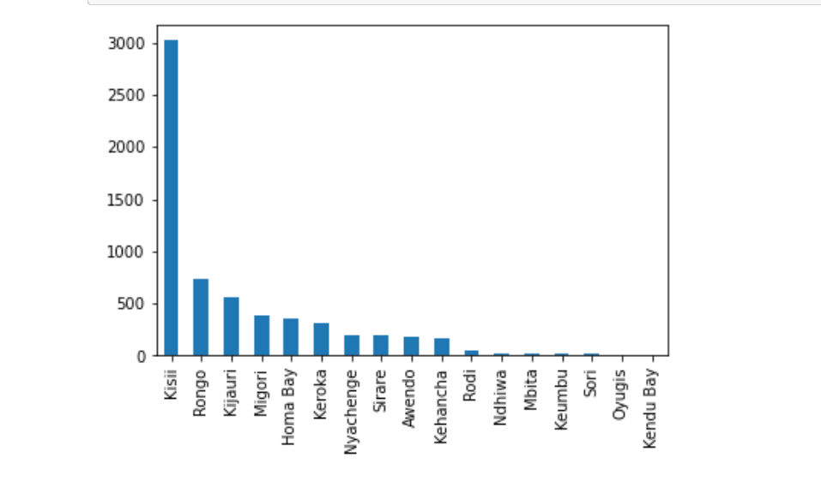
Count people travel location
According to this bar plot we can see the most of people travel from kisii and rongo. but something 3000 people travel from kisii .

Slide 10
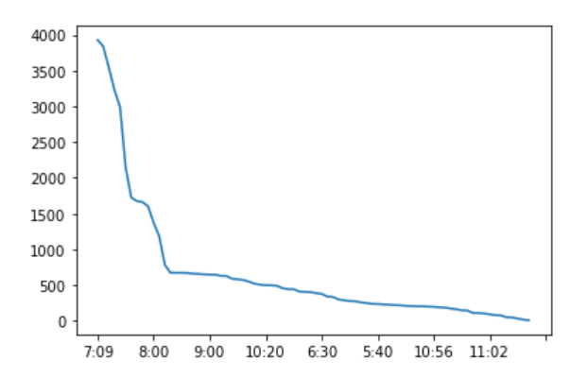
Count travellers travel time
By this chart we can see the most of people travel between 7’o clock to 8 o clock. We assume this is a office time of people .

Slide 11
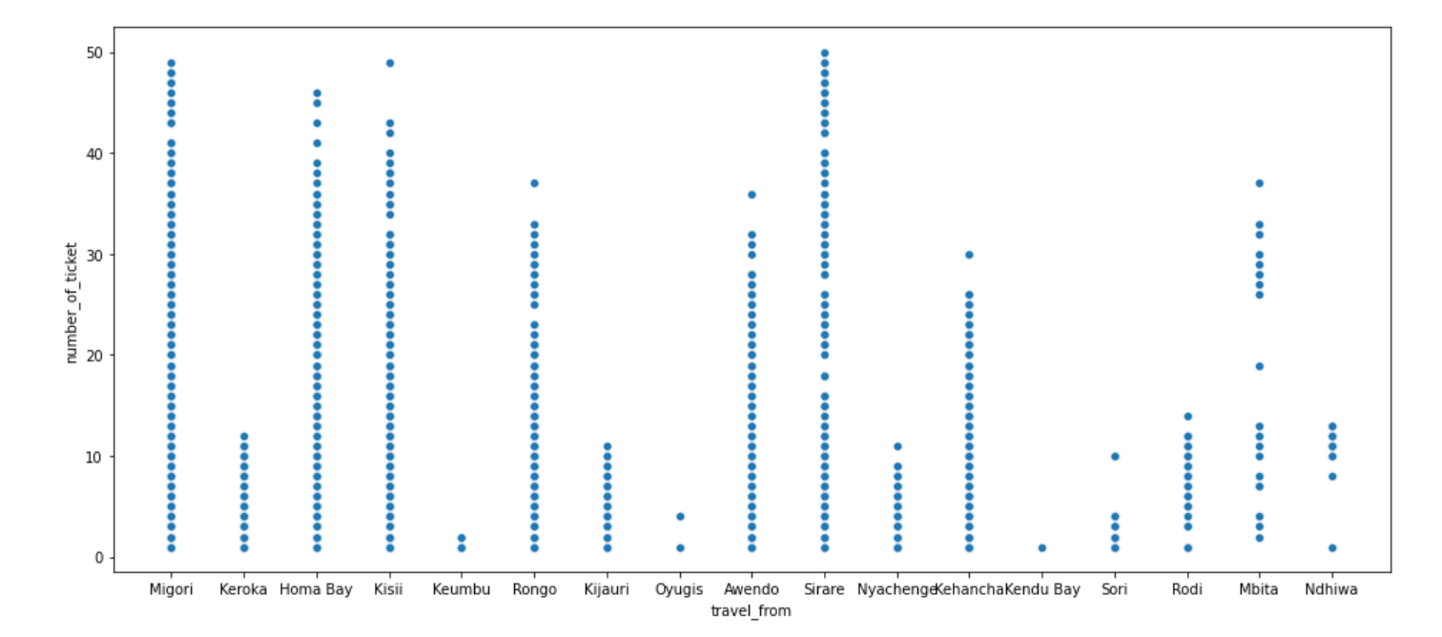
Count the number of tickets on traveling location
:
Migori , homa bay , srare ,kissi that’s the place where most number of ticket is sell

Slide 12
Cleanse and validate data
This step is crucial for removing faulty data and filling in gaps. Important tasks here includes: Removing extraneous data Filling in missing values. Conforming data to a standardized pattern

Slide 13
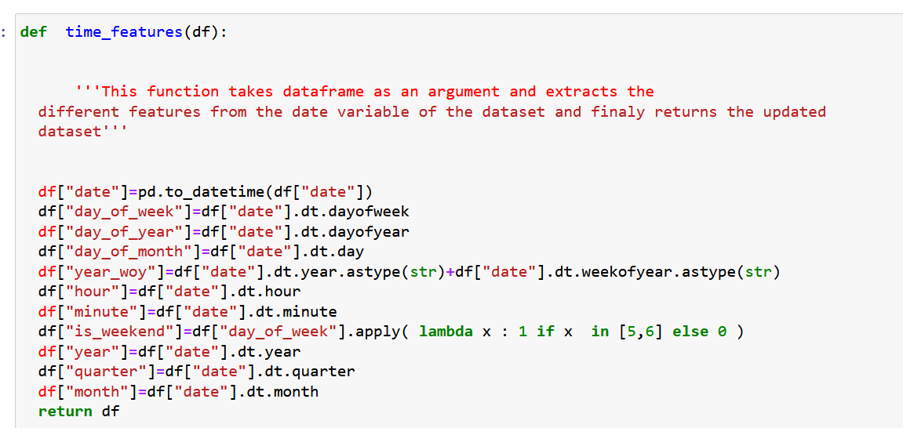
Data cleaning
Date is a very useful features of input variable . So this function take a date as input and make a separate columns for all

Slide 14
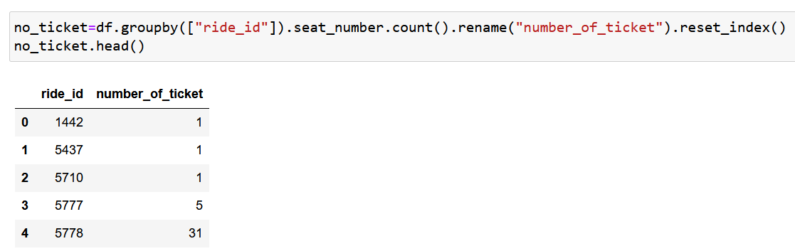
Finding target variable
We can group ride id and count seat number value to find target variable

Slide 15
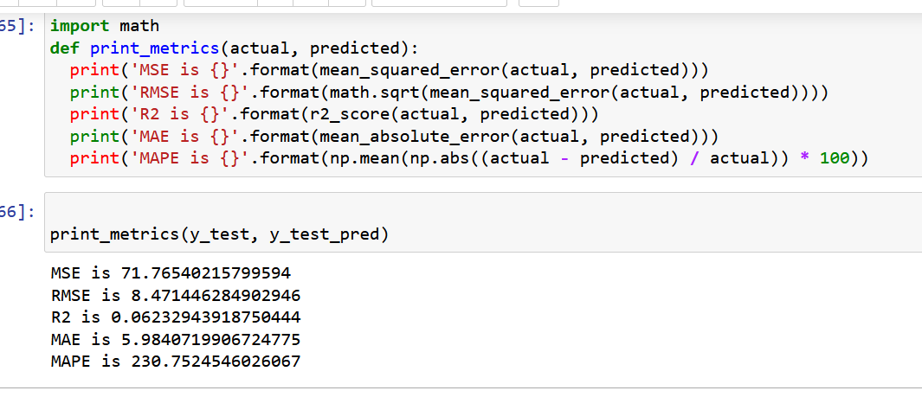
Implement linier regression
we can see linier regression is perform bad prediction . R2 score is bad .MSE and RMSE is high so this model the a best fit model

Slide 16
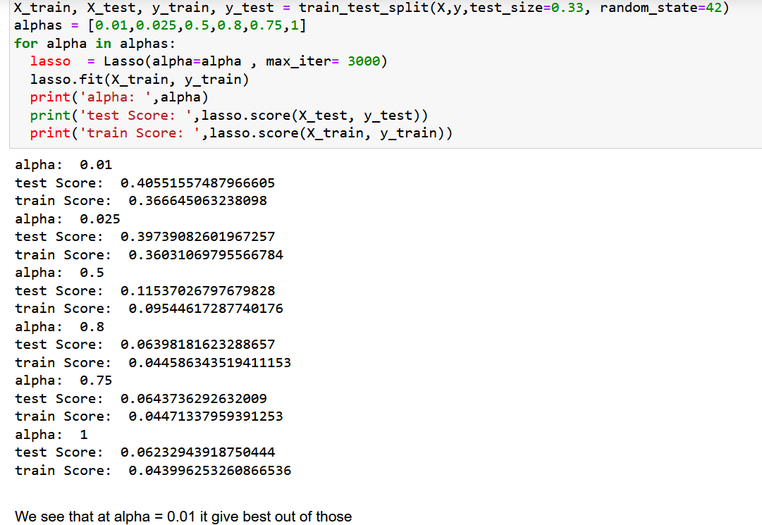
Implement lasso regression
Lasso regression is not doing a good prediction . Alpha 0.01 training and testing score is good out of those but not a good fit model

Slide 17
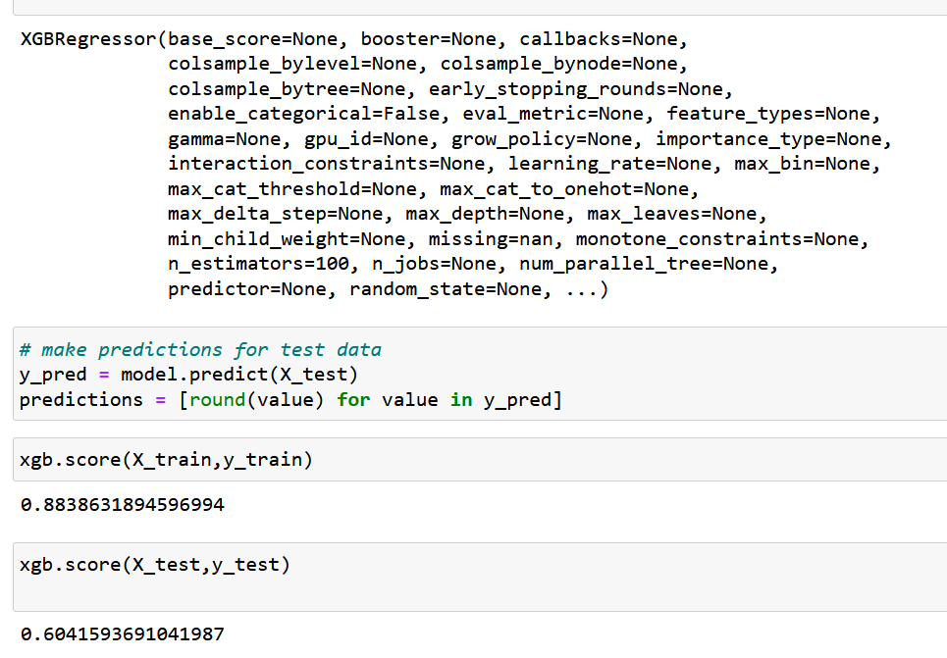
Implement XGBoost
After used XGBoost algorithm we can see training and tasting score is good .

Slide 18
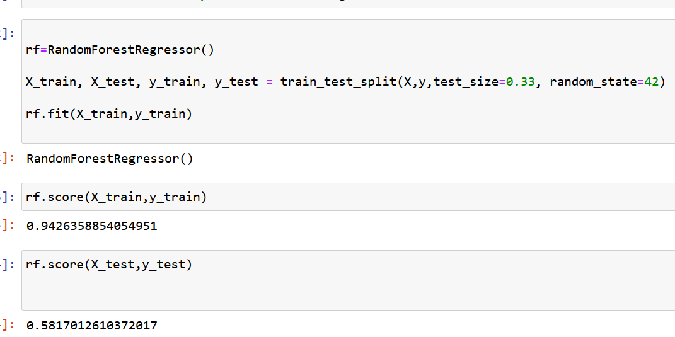
Implement random forest classifier
Training score is very good but testing score of random classifier is low

Slide 19
Conclusion
We used diffent type of regression algorithms to train our model like, Linear Regression, Regularized linear regression (Lasso), GBM,Random Forest Regressor, XGboost regressor. and Also we tuned the parameters of Random forest regressor and XGboost regressor and also found the important features for training the model. Out of them XGboost with tuned hyperparameters gave the best result.

Slide 20
Thank You

